Slide 1
CHAPTER 1:
JAVA BASIC

Slide 2
Objectives
1. Understand about identifiers, variables and constants
2. Understand and know how to use operator, give the right data type for using variables, and control structures.
3. Write Java application program that include identifiers, variables and constants and also use appropriate control structure.

Slide 3
Introduction
History of Java
● Developed by a team led by James Gosling, Sun Microsystems.
● Originally called Oak
● Designed for use in electronic applications.
● Redesigned for developing Internet applications.
● Renamed as Java on 20th May 1995.

Slide 4
Why Java?
Java enables users to develop and deploy applications on the Internet for servers, desktop computers, and small hand-held devices.
Java is a general purpose programming language.
Java is the Internet programming language.

Slide 5
Java, Web, and Beyond
Java can be used to develop applications.
Java Applets
Java Web Applications
Java can also be used to develop applications for hand-held devices such as Palm and cell phones

Slide 6
Characteristics of Java
Java is simple
Java is partially modeled on C++, but greatly simplified and improved. Some people refer to Java as "C++--" because it is like C++ but with more functionality and fewer negative aspects.
Java Is Object-Oriented
Java is inherently object-oriented. Many object-oriented languages began strictly as procedural languages, Java was designed from the start to be object-oriented.
Object-oriented programming (OOP) is a popular programming approach that is replacing traditional procedural programming techniques.

Slide 7
Characteristics of Java
Java Is Distributed
Distributed computing involves several computers working together on a network. Java is designed to make distributed computing easy. Networking capability is inherently integrated into Java.
Java Is Interpreted
Need an interpreter to run Java programs. Programs are compiled into the Java Virtual Machine code called bytecode. The bytecode is machine-independent and can run on any machine that has a Java interpreter, which is part of the Java Virtual Machine (JVM).

Slide 8
Characteristics of Java
Java Is Robust
Java compilers can detect many problems that would first show up at execution time in other languages.
Java has eliminated certain types of error-prone programming constructs found in other languages.
Java has a runtime exception-handling feature to provide programming support for robustness.
Java Is Secure
Java implements several security mechanisms to protect your system against harm caused by stray programs.

Slide 9
Characteristics of Java
Java Is Architecture-Neutral
Write once, run anywhere.
With a Java Virtual Machine (JVM), you can write one program that will run on any platform.
Java Is Portable
Because Java is architecture neutral, Java programs are portable. They can be run on any platform without being recompiled.

Slide 10
Characteristics of Java
Java’s Performance
Java has a higher performance capability compared to some other languages.
Java Is Multithreaded
Multithread programming is smoothly integrated in Java, whereas in other languages you have to call procedures specific to the operating system to enable multithreading.

Slide 11
Characteristics of Java
Java Is Dynamic
Java was designed to adapt to an evolving environment. New code can be loaded on the fly without recompilation. There is no need for developers to create, and for users to install, major new software versions. New features can be incorporated transparently as needed.

Slide 12
JDK Editions
Java Standard Edition (J2SE)
  J2SE can be used to develop client-side standalone applications or applets.
Java Enterprise Edition (J2EE)
  J2EE can be used to develop server-side applications such as Java servlets and Java ServerPages.
Java Micro Edition (J2ME).
  J2ME can be used to develop applications for mobile devices such as cell phones.

Slide 13
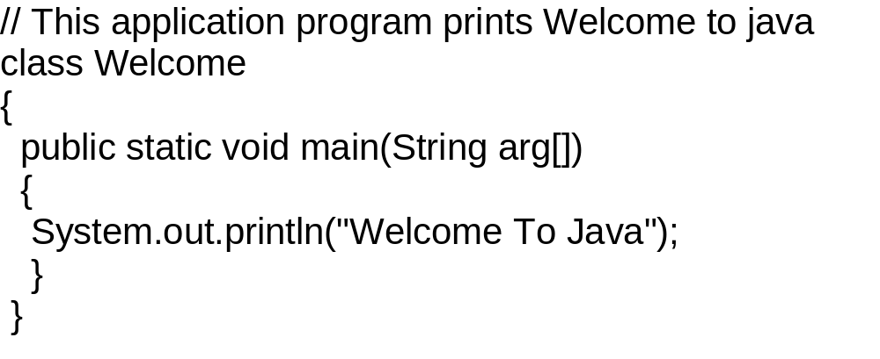
A simple Java Application program:
class name

Slide 14
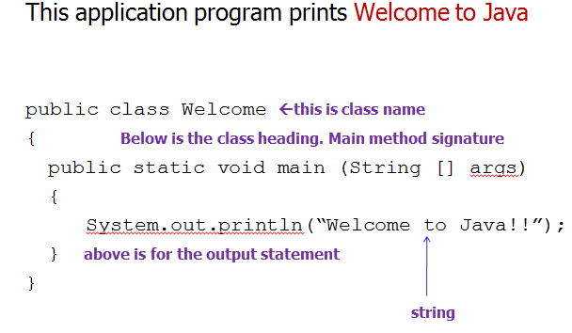

Slide 15
QUESTION 1:
Identify and fix the errors in the following code:
public class Welcome
{
public void Main (String [] args)
{
System.out.println (‘Welcome to java’)
}
}

Slide 16

Compiling and Running Java from the Command Window
Save a file with the same name as the class:
Welcome.java
Java program source file must end with the extension “.java”
Compile
javac Welcome.java
Run
java Welcome

Slide 17
Anatomy of a Java Program
- Comments -
Three types of comments in Java.
Line comment: A line comment is preceded by two slashes (//) in a line.
Paragraph comment: A paragraph comment is enclosed between /* and */ in one or multiple lines.
javadoc comment: javadoc comments begin with /** and end with */. They are used for documenting classes, data, and methods. They can be extracted into an HTML file using JDK's javadoc command.

Slide 18
Anatomy of a Java Program
-Package-
Java allows program to be written and kept as packages. A package is like a folder.
Package statement must be written at the top most of a program.

Slide 19
Anatomy of a Java Program
-Reserved Words-
Reserved words or keywords are words that have a specific meaning to the compiler and cannot be used for other purposes in the program.
For example, when the compiler sees the word class, it understands that the word after class is the name for the class.

Slide 20
Anatomy of a Java Program
-Modifiers-
Java uses certain reserved words called modifiers that specify the properties of the data, methods, and classes and how they can be used/accessed.
Examples of modifiers are public and static. Other modifiers are private, final, abstract, and protected. A public datum, method, or class can be accessed by other programs. A private datum or method cannot be accessed by other programs.

Slide 21
Anatomy of a Java Program
-Statements-
A statement represents an action or a sequence of actions.
The statement System.out.println("Welcome to Java!"); is a statement to display the greeting "Welcome to Java!“
Every statement in Java ends with a semicolon (;).

Slide 22
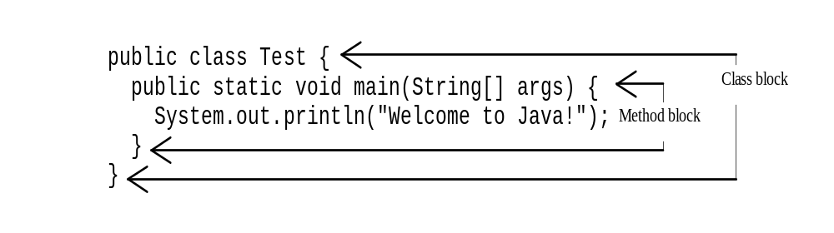
Anatomy of a Java Program
-Blocks-
A pair of braces in a program forms a block that groups components of a program.

Slide 23
Anatomy of a Java Program
-Classes-
The class is the essential Java construct.
A class is a template or blueprint for objects.
To program in Java, you must understand classes and be able to write and use them.
A program is defined by using one or more classes.

Slide 24
Anatomy of a Java Program
-Methods-
A method: a collection of statements that performs a sequence of operations.
It can be used even without fully understanding the details of how it works.
For example: System.out.println() method is used to display a message on the console. It is used by invoking a statement with a string argument. The string argument is enclosed within parentheses.

Slide 25
Anatomy of a Java Program
-main Method-
The main method provides the control of program flow. The Java interpreter executes the application by invoking the main method.
The main method looks like this:
public static void main(String[] args) {
// Statements;
}

Slide 26
QUESTION 2
Write simple java program that must consists you name for the
first line. Second line your age and third line is your comment
about this course by using the comment symbol.

